Slide 1
DevOps culture Organizing DevOps Teams and Architecture According to Conway’s Law
Notes:
Author: Ahmed Hosni
1

Slide 2
Agenda
Part 1:
Problems Often Caused by Overly Functional Orientation (‘Optimizing for Cost’).
Enable Market-Oriented Teams (‘Optimizing for Speed’).
Making Functional Orientation Work.
Testing, Operations, and Security as Everyone’s Job, Every Day.
Fund Not Projects, Rather Services and Products Instead.
Design Team Boundaries in Accordance with Conway’s Law.
Enable Every Team Member to Be a Generalist.
Rethink team structures, purpose and interaction
Case studies: Spotify and Amazon.
Part 2:
Pairing and mobbing: Discuss and experience 3 foundational practices
Demo day: Experiment with the optimal methods of producing a showcase.
Retrospectives, information radiators, and team sentiment
Workshop
2

Slide 3
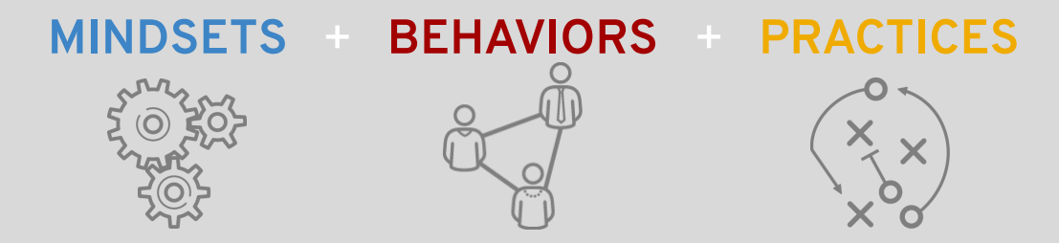
What are the Cultural Values of DevOps?
There are certain cultural principles and values of DevOps, that are intertwined with the values of Open Source communities, how open source projects work and agile ways of working, that can create a DevOps culture.

Slide 4
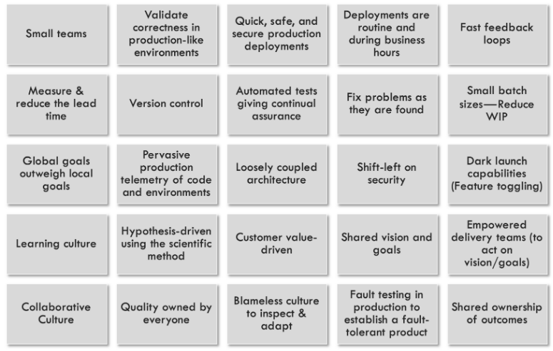
From ‘The DevOps Handbook’
DevOps Practices

Slide 5
Organizational patterns for DevOps
Notes:
Author: Ahmed Hosni
5

Slide 6
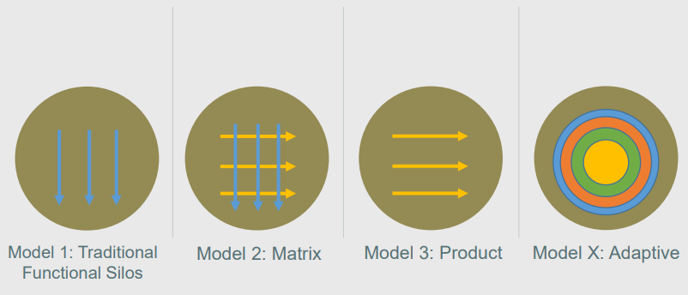
Organizational structures

Slide 7
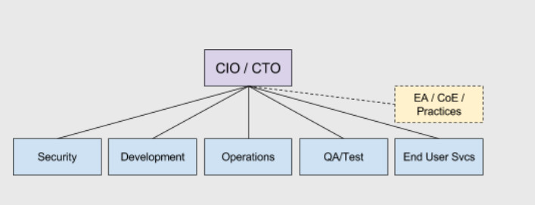

MODEL 1: Functional Silos

Slide 8
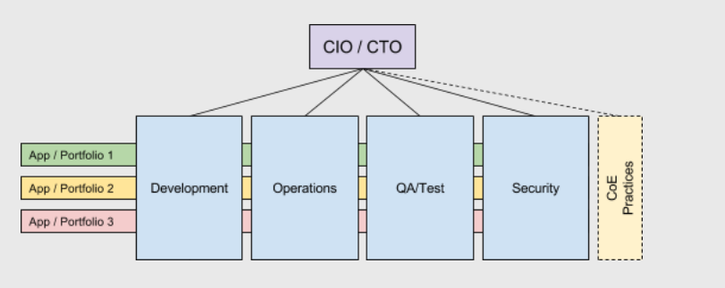

MODEL 2A: Matrix

Slide 9
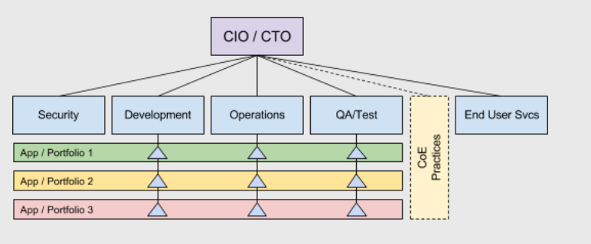
MODEL 2B: Matrix Embedded Functions

Slide 10
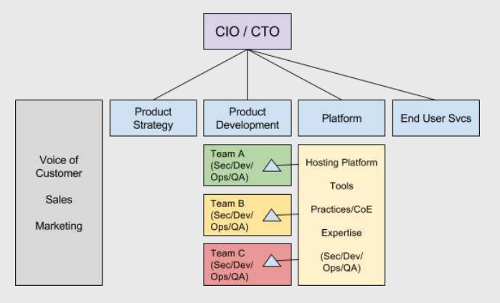

MODEL 3: Product

Slide 11
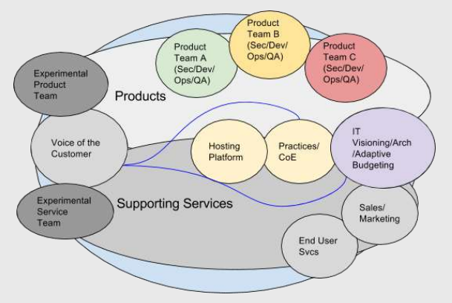

MODEL X: Adaptive

Slide 12
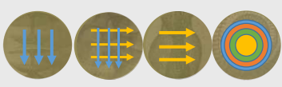
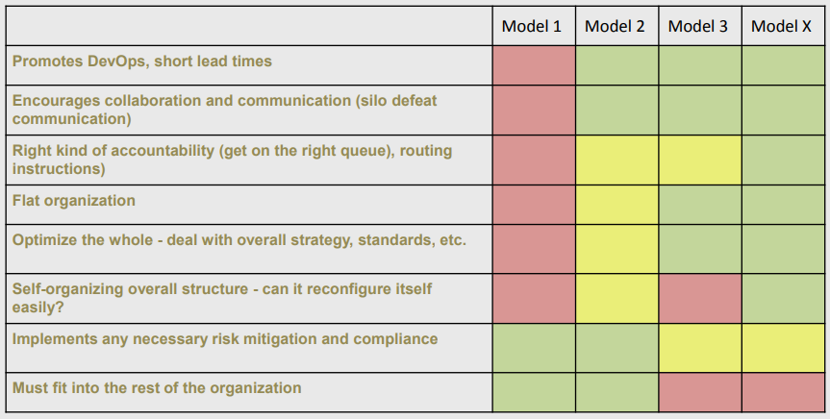
SUMMARY

Slide 13
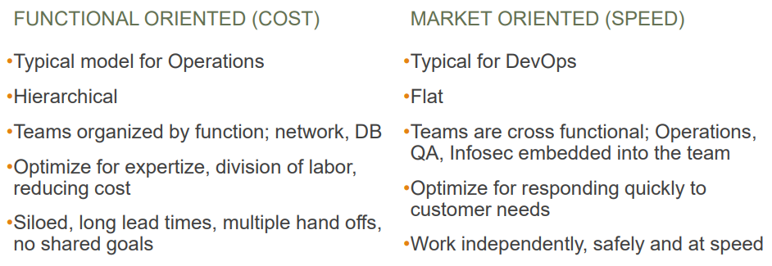
Axe’s organizational archetype?

Slide 14
Problems Often Caused by Overly Functional Orientation (‘Optimizing for Cost’)
Notes:
Author: Ahmed Hosni
14

Slide 15
Pain Points
Traditional IT teams tend to split and organize themselves according to specialty.
This has a compounding effect on the value stream by vastly reducing work flow and exacerbating long lead times.
Other problems:
Poor handoff coordination,
An increased amount of re-work
Low-quality results
Bottlenecks are more widespread too.

Slide 16
Do not dismiss functional-orientation entirely

Slide 17
Enable Market-Oriented Teams (‘Optimizing for Speed’)

Slide 18
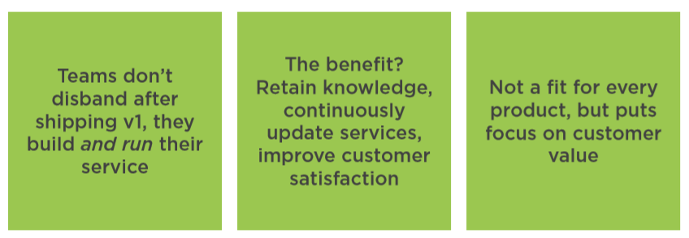
Create Permanent Teams Around Core Products

Slide 19
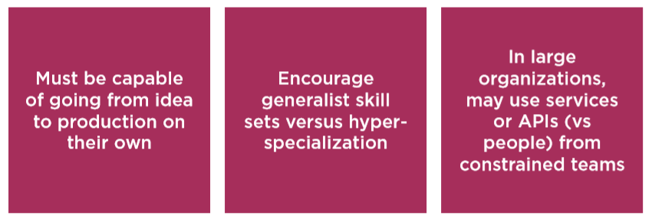
To Achieve Velocity, You Need Complete Teams

Slide 20
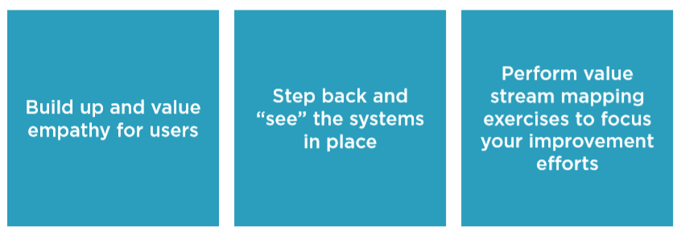
Understand Your Customers and Value Streams

Slide 21
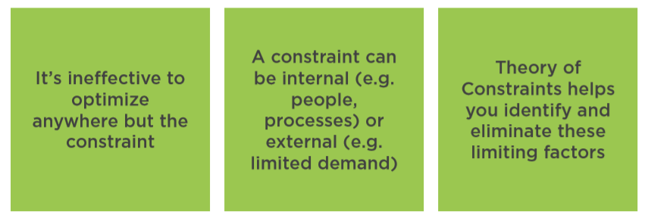
Put the Spotlight on Bottlenecks

Slide 22
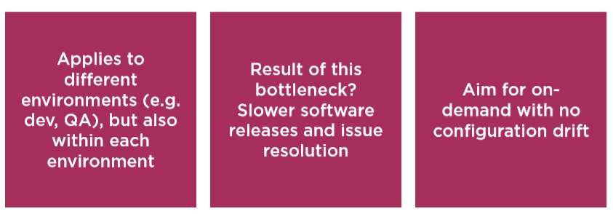
Do Away with Inconsistent Environments

Slide 23
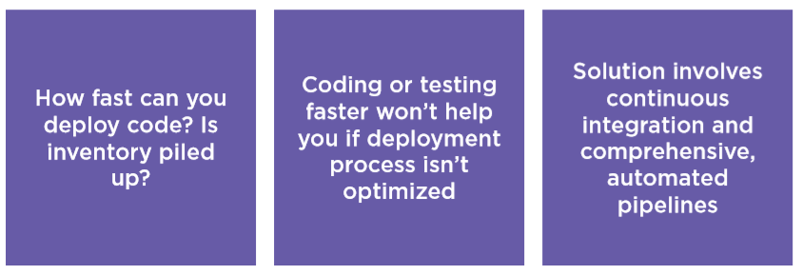
Automate the Path to Production

Slide 24
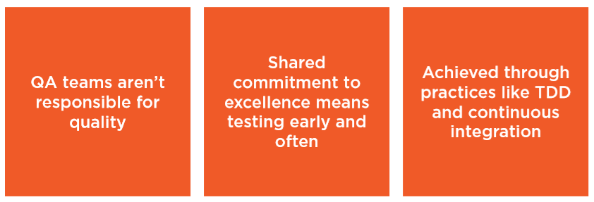
Build in Quality Up-front

Slide 25
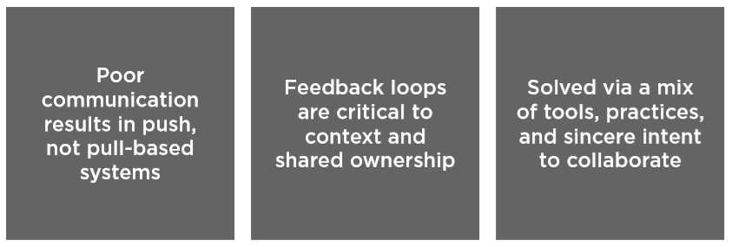
Break Down Communication Barriers

Slide 26
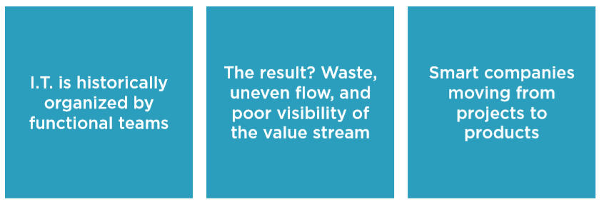
Rethink and Rebuild your Teams

Slide 27
Overcoming Objections Making Functional Orientation Work

Slide 28
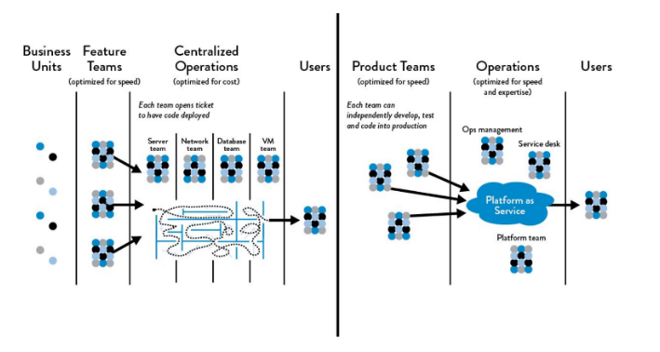
Do not dismiss functional-orientation entirely
Functional vs. Market Orientation Work: The DevOps Handbook (1st ed. 2016) Kim et al.
Notes:
In the right high-trust culture, organizations can achieve high-velocity, effective work flow by enabling automated self-service platforms and promoting full transparency in work prioritization.

Slide 29
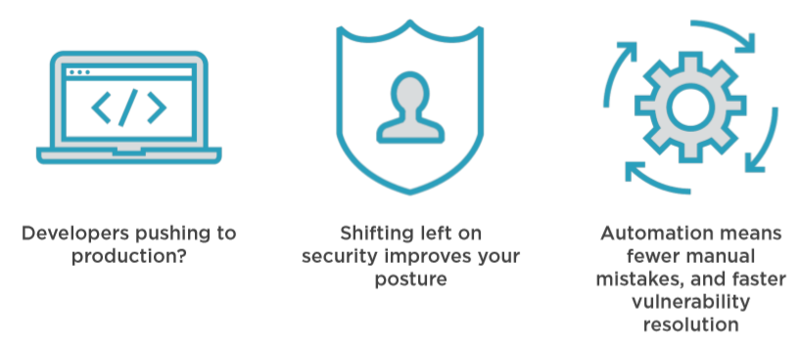
Objection: “DevOps makes us less secure.”

Slide 30
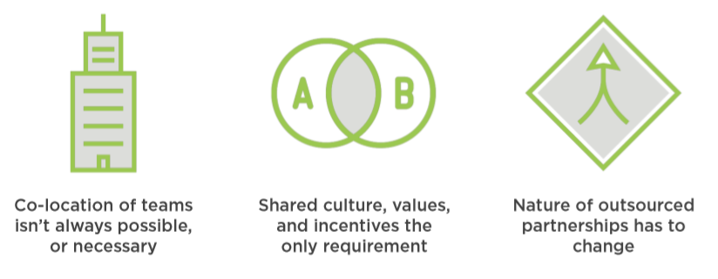
Objection: “We have offshore teams.”

Slide 31
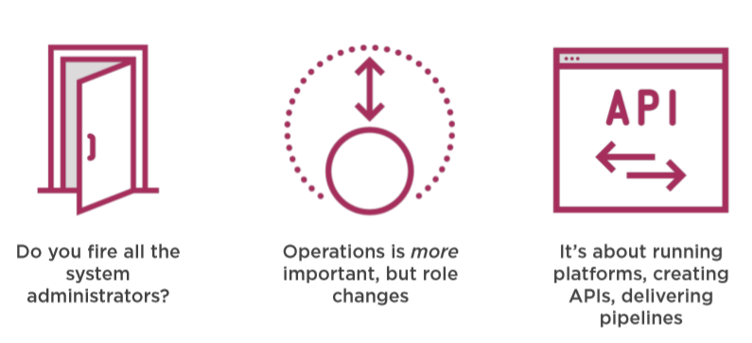
Objection: “You’re eliminating our Ops team.”

Slide 32
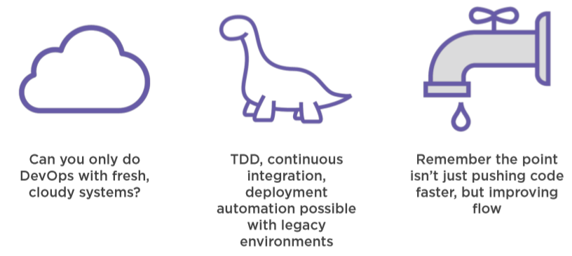
Objection: “I’ve got too much COTS and legacy code.”

Slide 33

Objection: “We don’t have these skills.”

Slide 34
DevOps Team Topologies

Slide 35
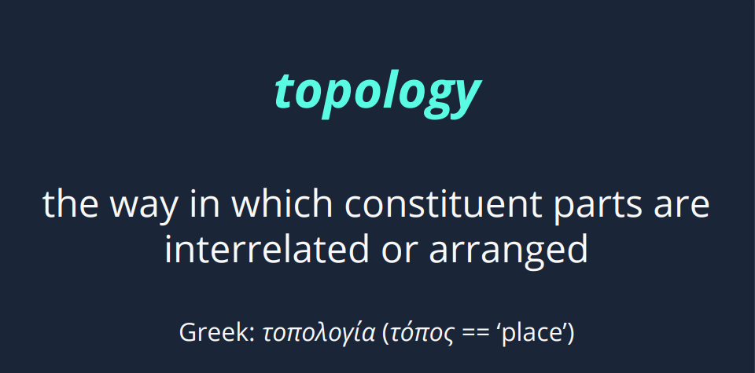

Slide 36
DevOps Anti-Types
It’s useful to look at some bad practices, what we might call ‘anti-types’ (after the ubiquitous ‘anti-pattern‘).
It’s useful to look at some bad practices, what we might call ‘anti-types’ (after the ubiquitous ‘anti-pattern‘).
A: Dev vs Ops
B: DevOps Silo
C: No Ops Needed
D: Tools Team
E: SysAdmin
F: Embedded Ops
G: Dev vs DBA

Slide 37
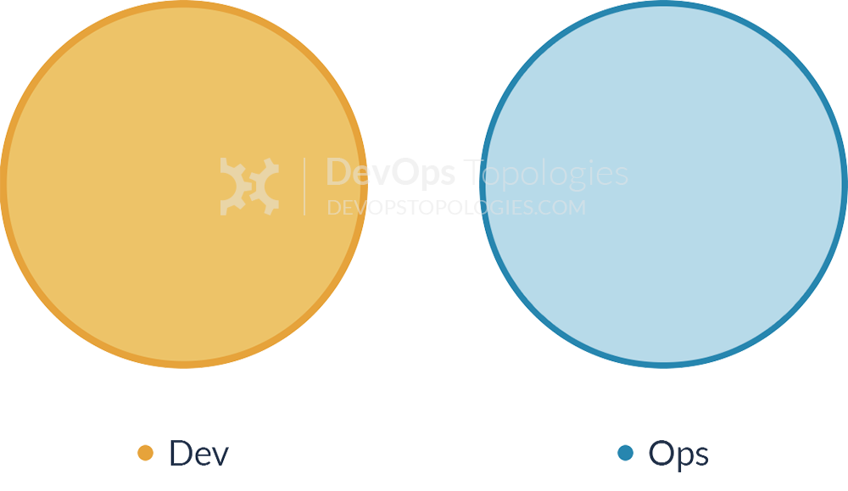
Anti-Type A: Dev and Ops Silos
This is the classic ‘throw it over the wall’ split between Dev and Ops.
It means that story points can be claimed early (DONE means ‘feature-complete’, but not working in Production), and software operability suffers because Devs do not have enough context for operational features and Ops folks do not have time or inclination to engage Devs in order to fix the problems before the software goes live.
We likely all know this topology is bad, but I think there are actually worse topologies; at least with Anti-Type A (Dev and Ops Silos), we know there is a problem.

Slide 38
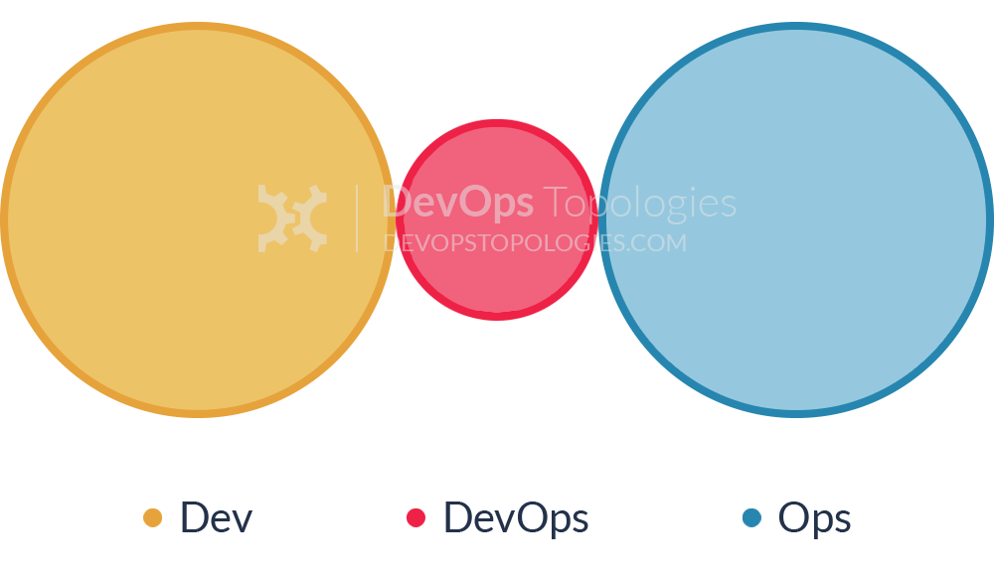
Anti-Type B: DevOps Team Silo
The DevOps Team Silo (Anti-Type B) typically results from a manager or exec deciding that they “need a bit of this DevOps thing” and starting a ‘DevOps team’ (probably full of people known as ‘a DevOp‘). The members of the DevOps team quickly form another silo, keeping Dev and Ops further apart than ever as they defend their corner, skills, and toolset from the ‘clueless Devs’ and ‘dinosaur Ops’ people.

Slide 39
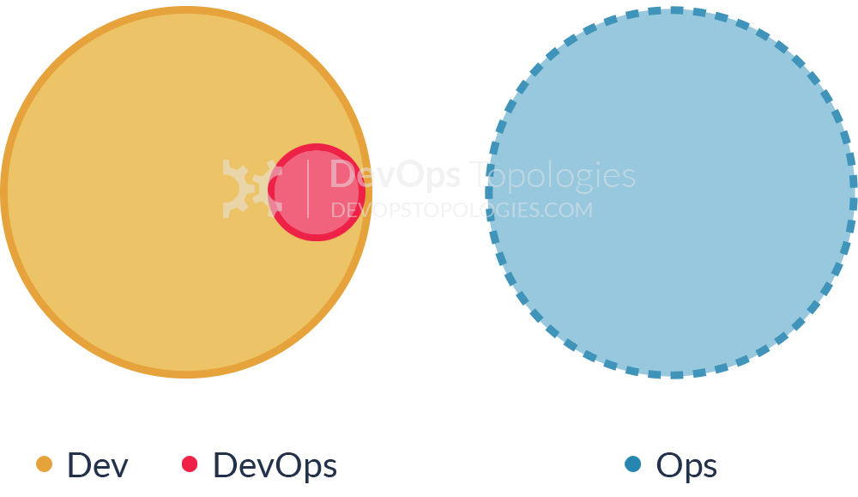
Anti-Type C: Dev Don't Need Ops
The DevOps Team Silo (Anti-Type B) typically results from a manager or exec deciding that they “need a bit of this DevOps thing” and starting a ‘DevOps team’ (probably full of people known as ‘a DevOp‘). The members of the DevOps team quickly form another silo, keeping Dev and Ops further apart than ever as they defend their corner, skills, and toolset from the ‘clueless Devs’ and ‘dinosaur Ops’ people.

Slide 40
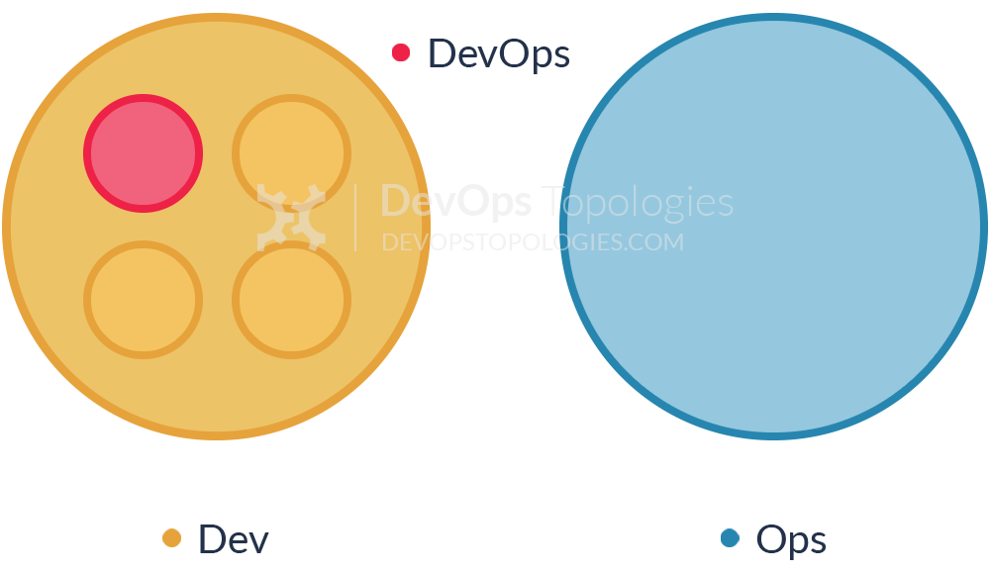
Anti-Type D: DevOps as Tools Team
The DevOps Team Silo (Anti-Type B) typically results from a manager or exec deciding that they “need a bit of this DevOps thing” and starting a ‘DevOps team’ (probably full of people known as ‘a DevOp‘). The members of the DevOps team quickly form another silo, keeping Dev and Ops further apart than ever as they defend their corner, skills, and toolset from the ‘clueless Devs’ and ‘dinosaur Ops’ people.

Slide 41
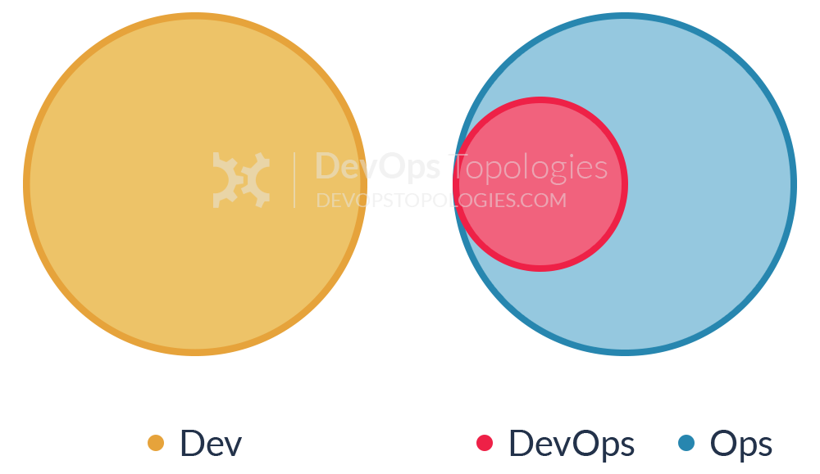
Anti-Type E: Rebranded SysAdmin
The DevOps Team Silo (Anti-Type B) typically results from a manager or exec deciding that they “need a bit of this DevOps thing” and starting a ‘DevOps team’ (probably full of people known as ‘a DevOp‘). The members of the DevOps team quickly form another silo, keeping Dev and Ops further apart than ever as they defend their corner, skills, and toolset from the ‘clueless Devs’ and ‘dinosaur Ops’ people.

Slide 42
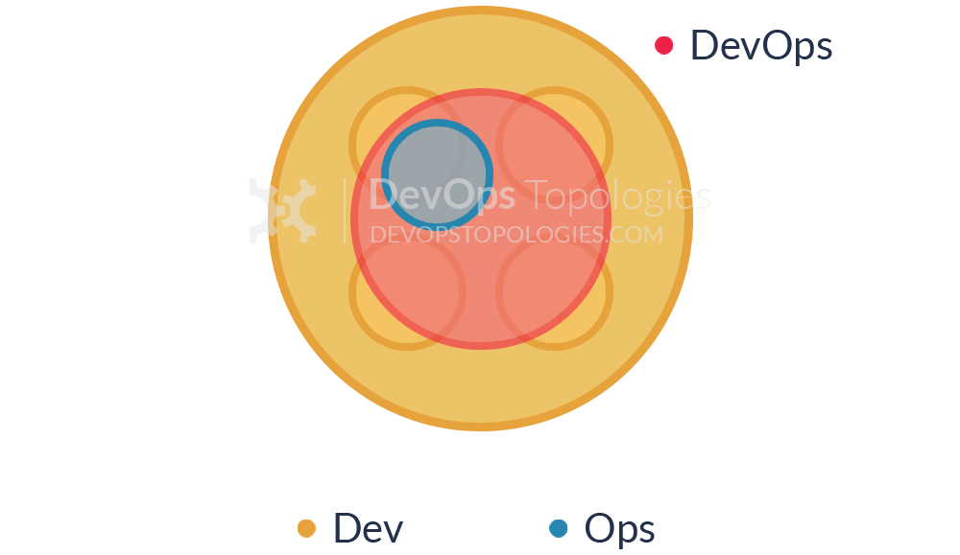
Anti-Type F: Ops Embedded in Dev Team
The DevOps Team Silo (Anti-Type B) typically results from a manager or exec deciding that they “need a bit of this DevOps thing” and starting a ‘DevOps team’ (probably full of people known as ‘a DevOp‘). The members of the DevOps team quickly form another silo, keeping Dev and Ops further apart than ever as they defend their corner, skills, and toolset from the ‘clueless Devs’ and ‘dinosaur Ops’ people.

Slide 43
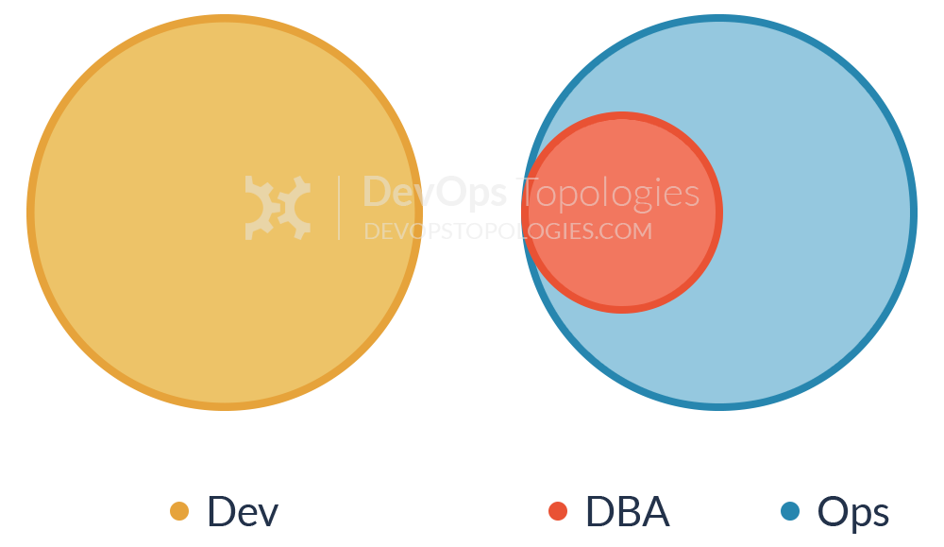
Anti-Type G: Dev and DBA Silos
The DevOps Team Silo (Anti-Type B) typically results from a manager or exec deciding that they “need a bit of this DevOps thing” and starting a ‘DevOps team’ (probably full of people known as ‘a DevOp‘). The members of the DevOps team quickly form another silo, keeping Dev and Ops further apart than ever as they defend their corner, skills, and toolset from the ‘clueless Devs’ and ‘dinosaur Ops’ people.

Slide 44
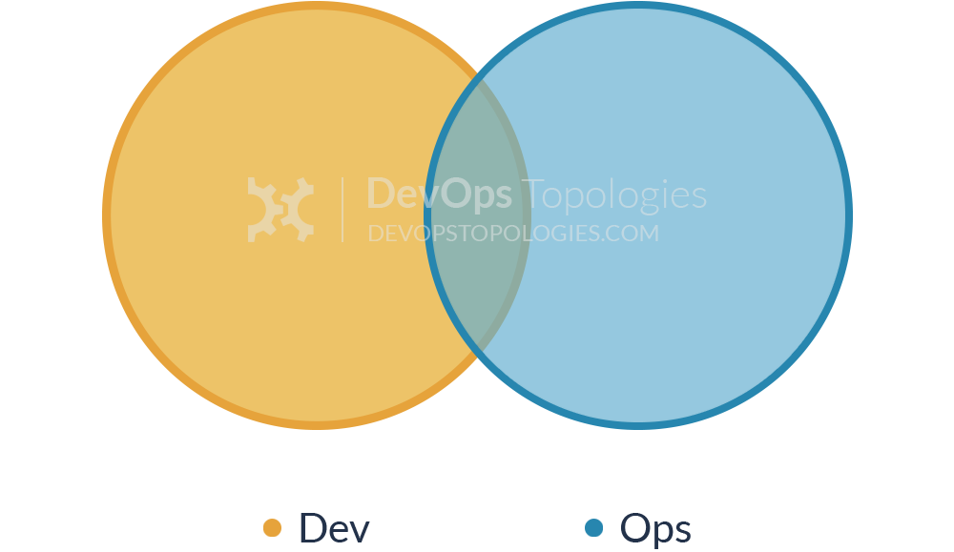
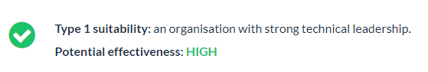
Type 1: Dev and Ops Collaboration

Slide 45
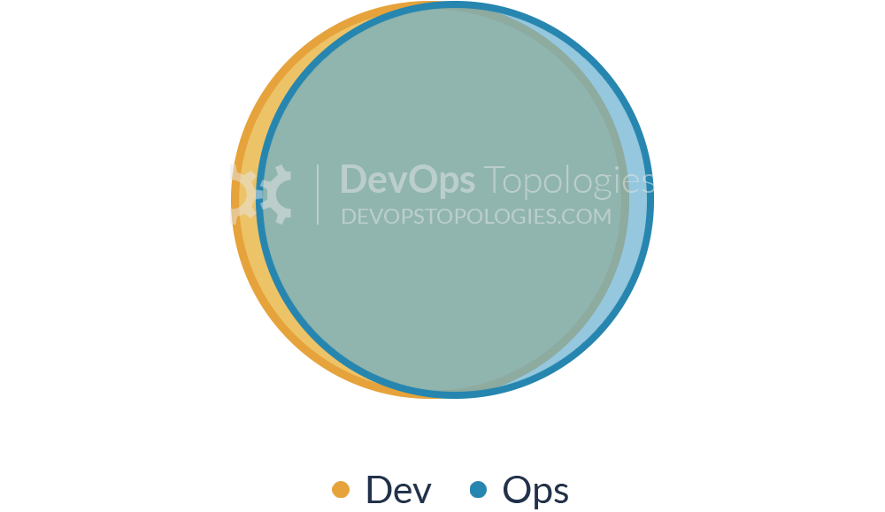
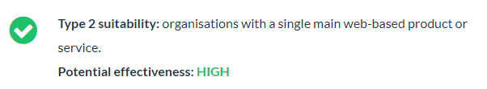
Type 2: Fully Shared Ops Responsibilities

Slide 46
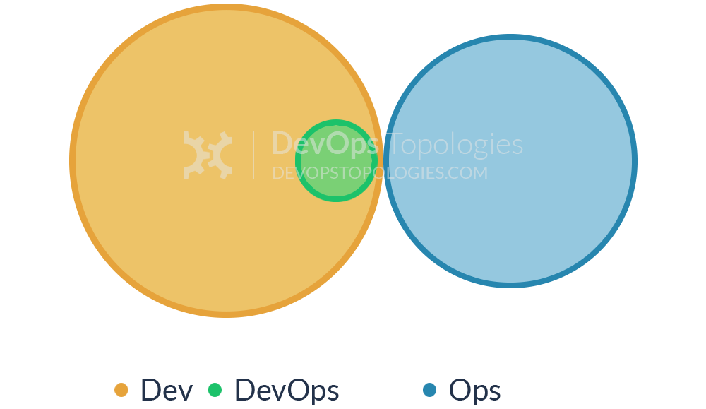
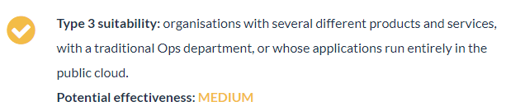
Type 3: Ops as Infrastructure-as-a-Service (Platform)

Slide 47
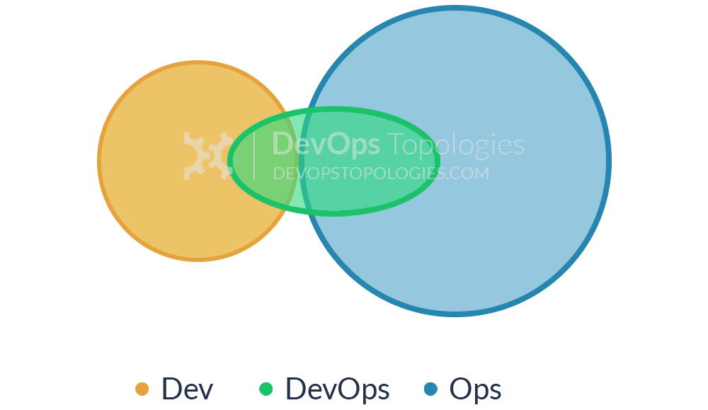
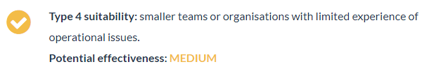
Type 4: DevOps as an External Service

Slide 48
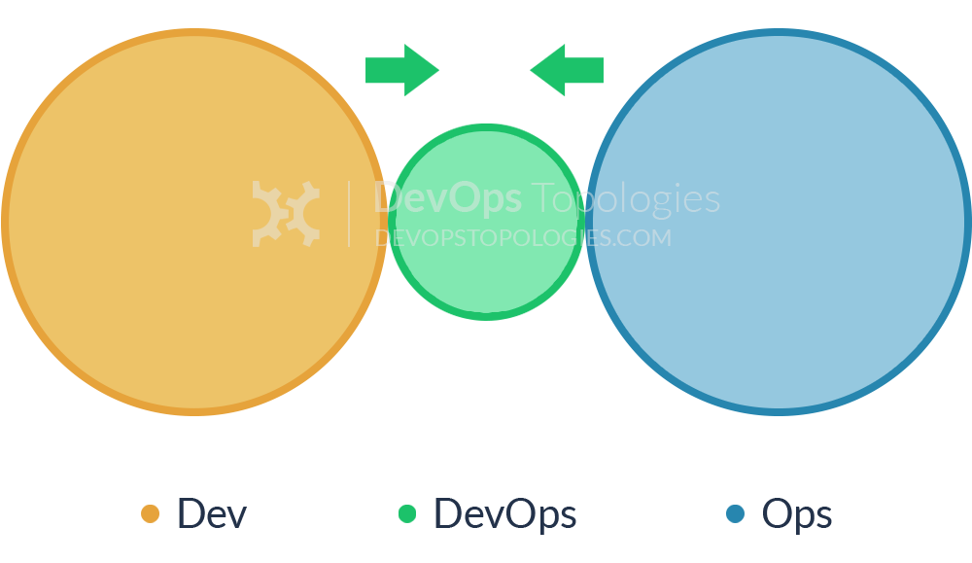
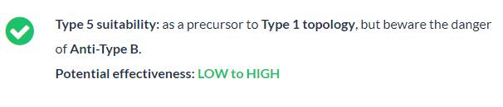
Type 5: DevOps Team with an Expiry Date

Slide 49
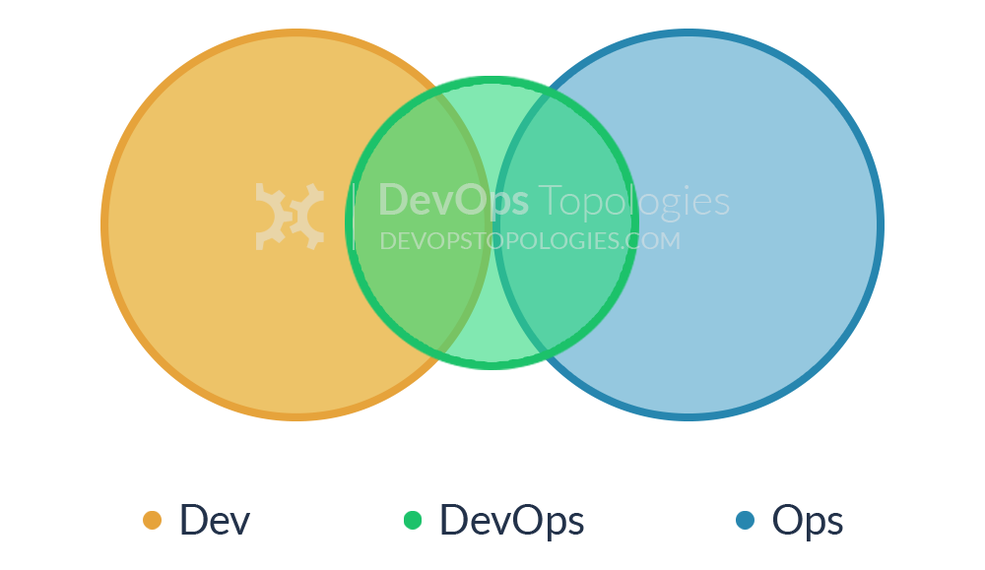
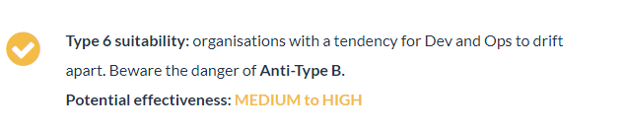
Type 6: DevOps Advocacy Team

Slide 50
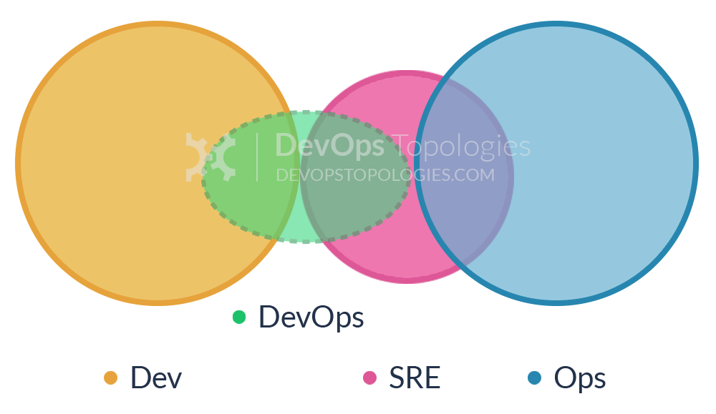
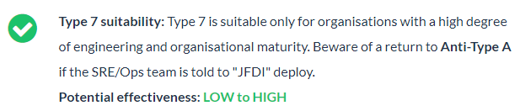
Type 7: SRE Team (Google Model)

Slide 51
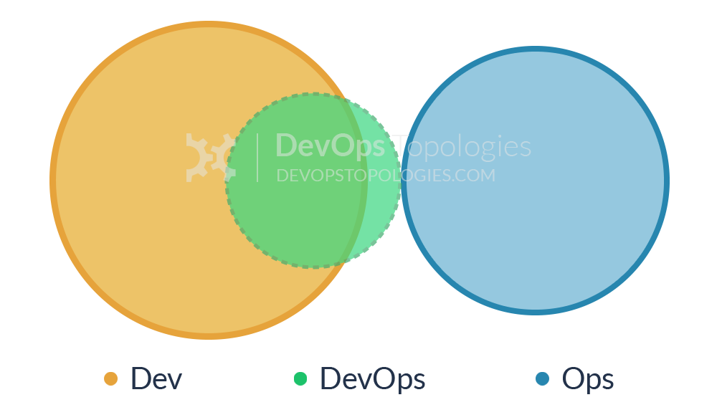
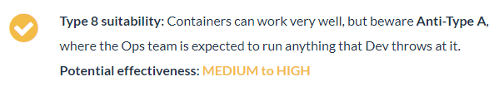
Type 8: Container-Driven Collaboration

Slide 52
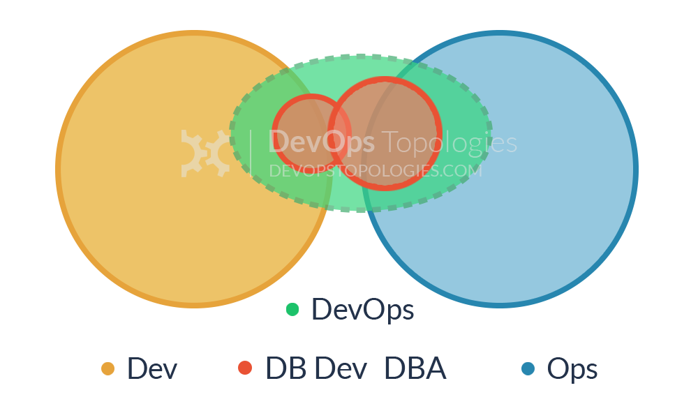

Type 9: Dev and DBA Collaboration

Slide 53
Fund Not Projects, Rather Services and Products Instead

Slide 54
Do not dismiss functional-orientation entirely

Slide 55
Enable Every Team Member to Be a Generalist

Slide 56
Do not dismiss functional-orientation entirely
Over-specialization, an extreme consequence of functional-orientation, can cause siloization.
When team members are isolated in their contributions to the value stream and have no alignment with others.
To counter this, encourage people to become generalists by providing varied opportunities for skills development.
Encourage a growth mindset in the organization and hire for generalist skills.

Slide 57

Do not dismiss functional-orientation entirely

Slide 58
Format des requêtes
58

Slide 59
Format des requêtes
59

Slide 60
Design Team Boundaries in Accordance with Conway’s Law

Slide 61

CONWAY’S LAW
“Organizations which design systems… are constrained to produce designs which are copies of the communication structures of these organizations”
-- M. Conway
Notes:
CONWAY’S LAW HAS A TREMENDOUS IMPACT ON THE PERFORMANCE OF OUR VALUE STREAM.

Slide 62

CONWAY’S LAW
In 1968, Dr. Conway was performing a famous experiment:
Together, with a contract research organization of eight people, they were commissioned to produce a COBOL and an ALGOL compiler.
During the experiment, he observed, “After some initial estimates of difficulty and time, five people were assigned to the COBOL job and three to the ALGOL job. The resulting COBOL compiler ran in five phases, the ALGOL compiler ran in three.”

Slide 63

CONWAY’S LAW

Slide 64

4 fundamental topologies for fast flow
Notes:
CONWAY’S LAW HAS A TREMENDOUS IMPACT ON THE PERFORMANCE OF OUR VALUE STREAM.

Slide 65

4 fundamental topologies for fast flow

Slide 66
3 core interaction modes

Slide 67

3 core interaction modes

Slide 68

Triggers for change

Slide 69

Triggers for change

Slide 70

Team Topologies for fast flow

Slide 71
Rethink team structures, purpose and interaction

Slide 72

Explicit cognitive load

Slide 73

Large Conway mismatches

Slide 74

Team Interactions

Slide 75

Thinnest Viable Platform

Slide 76


The “Spotify model” helps to

Slide 77

We also need to address

Slide 78
Case studies: Spotify

Slide 79

The Spotify model

Slide 80

The Spotify model
Notes:
Henrik Kniberg & Anders Ivarsson, 2012
https://blog.crisp.se/wp-content/uploads/2012/11/SpotifyScaling.pdf

Slide 81

Case studies: Amazon

Slide 82

Vision
82

Slide 83

Jeff Bezos’ Big Mandate (2001) Steve Yegge’s Architecture Rant
83

Slide 84

A Look Back: Development transformation

Slide 85

Every Team is a DevOps team
85

Slide 86

Amazon S3 at launch

Slide 87

Amazon S3 today

Slide 88

The recipe
88

Slide 89

The recipe
89

Slide 90

The recipe
90

Slide 91

Pipelines
91

Slide 92

Monolith development lifecycle
92

Slide 93

Microservice development lifecycle
93

Slide 94

Pipelines
94
Notes:
•2011: Amazon performs approximately seven thousand deploys per day
•2015: 130,000 deploys per day • ~50 million deploys/year

Slide 95

2 Pizza Team Responsibility Venn Diagram
95

Slide 96

2 Pizza Team Responsibility Venn Diagram
96

Slide 97

Practices and Patterns
97

Slide 98

Automate everything
98

Slide 99

Belts and suspenders
99

Slide 100

Standardize Tools
100

Slide 101
Culture Foundation

Slide 102
Core DevOps Practices
Discovery Practices | Delivery Practices | Culture of Collaboration practices | Technical Practices
Impact Mapping | Kanban | Social Contracting | Infrastructure as Code
Event Storming | Scrum | Team Sentiment | Continuous Integration
Value Stream Mapping | Visualisation of work | Realtime Retrospectives | Continuous Delivery
Metrics Based Process Mapping | Burnup/ Burndown | Backlogs | Test Automation
 | Retrospectives | Pairing | Test Driven Development
 | Definitions of Ready & Done | Mobbing
 | Estimation
102

Slide 103
Pairing and mobbing: Discuss and experience 3 foundational practices

Slide 104

Pair programming can be slow and frustrating

Slide 105
Pair programming Why use it?
Enable knowledge sharing between team members.
Building of trust between team members.
Increased quality of work as it is reviewed and improved simultaneously.
It is not for:
Teaching domain, Mentorship, Showing code, Getting confirmation or Finding bugs
105

Slide 106
Pair programming How to do it?
The team member behind the keyboard and mouse is the driver.
The driver is focused on performing the actual work.
The other team member is the navigator or observer.
The navigator is focused on the strategic outcome of the work being performed.
The navigator reviews the work being performed by the driver as it is done.
While reviewing, the navigator keeps in mind the end goal and ensures the current task is working towards it.
Switch the roles often, for example every 15 minutes, for the team members to experience the different aspects of the work.
106

Slide 107

Pair programming with A
107

Slide 108

Ping-Pong Programming
Ping-Pong Programming (aka. Ping-Pong Pair Programming) is a kind of Pair Programming that TDD (Test Driven Development) is included while in practice.
108

Slide 109
Ping-Pong Programming Why use it?
Easier to find the rhythm of the development flow which can be a problem when it comes to switching pairs.
TDD !!
A much smaller problem space needs to be managed, so this enables developers to sync with the flow quicker than other styles.
The work is gamified, so it puts another kind of motivation for developers.
Avoids mismatched pair issues -like one developer knows more than the other- as each developer takes turns writing tests and making them pass.
109

Slide 110

Ping-Pong Programming How to do it?
110
Notes:
The optimal setup to work in this rhythm is two developers sitting side by side, a single computer with two input devices:
That’s two monitors, two keyboards, and two mice. However, developers may do pairs remotely if they work in a remote environment via tools like Live Share etc.

Slide 111
Mob Programming What is it?
Mob programming is a practice where the whole team comes together to implement a feature or piece of functionality.
Like pair programming but with the whole team.
This practice can also be used as Mob learning when you quickly want to share new information that everyone in the team needs.
- Ensures the whole team understands how a specific feature is implemented or problem is solved.
- It can also be a quick way to onboard new team members.
111

Slide 112

Mob Programming How to do it?
112

Slide 113

Mob Programming How to do it?
Have one team member driving a laptop that is connected to a large screen or projector.
The person behind the keyboard and mouse is usually called “Driver” and the others would be “Navigators”.
The whole team then implement the feature together by talking through the development together.
113

Slide 114
Service model and technical practices

Slide 115

Service Model The Old Way: Assembly Line IT
115

Slide 116

Model 1: “Legacy”
116

Slide 117

Each Server Built This Way is A “Pet”
117

Slide 118

Model 2: Robotics Factory IT
118

Slide 119

Every Server is Just Another Part of the Herd
119

Slide 120

Model 1 vs Model 2
120

Slide 121

Every Server is Just Another Part of the Herd
121

Slide 122

Failures happen … Always
- Everything must fail without an impact:
Server components, servers, racks, datacenters … Everything!
- Most importantly, apps must detect and route around these failures.
122

Slide 123

Everything-as-Code Save everything as code: configuration, infrastructure and pipelines
- This means, storing configuration along with Source Code in an SCM.
- Storing the configuration from bottom to top (communication switches, bare metal servers, operating systems, build configurations,
application properties and deployment configurations…) as code means they are tracked and can be recreated at the click of a button.
123
Notes:
Everything as Code includes system design, also stored as code. In old world IT, infrastructure required specialized skills and physical hardware and cables to be installed.
Systems were precious or were not touched / updated often as the people who created them no longer work for the company.
The dawn of cloud computing and cloud native applications has meant it is cheap and easy to spin up virtual infrastructure.
By storing the configuration of virtual environments as code, they can be life-cycled and recreated whenever needed.

Slide 124
Why store all things as code?
1- Traceability:
Storing your config in git implies controls are in place to track who / why a config has changed.
Changes can be applied and reverted and are tracked to a single user who made the change.
124

Slide 125
Why store all things as code?
2- Repeatable:
Moving from one cloud provider to another should be simple in modern application development.
Picking a deployment target should be like shopping around for the best price that week.
By storing all things as code, systems can be re-created in moments in various providers.
125

Slide 126
Why store all things as code?
3- Tested:
Infra and code can be rolled out, validated and promoted into production environments with confidence and assurance it will behave as expected.
126

Slide 127
Why store all things as code?
4- Phoenix server:
No more fear of a servers’ configuration drifting.
If a server needs to be patched or randomly dies, it’s OK.
Just create it again from the stored configuration.
127

Slide 128
Why store all things as code?
5- Shared understanding:
When a cross-functional team is using ‘Everything as Code’ to describe all the parts of the Product they are developing together, they contribute to increase the shared understanding between Developers and Operations.
They speak same language to describe the state of this Product and they use the same frameworks to accomplish their goals.
128

Slide 129
Demo day: Experiment with the optimal methods of producing a showcase.

Slide 130
Showcase What is it?
An event where stakeholders and interested parties are given a demonstration of recent work performed by a team.
The latest increment of the product with new features built by the the team is showcased.
The event also provides an opportunity to review all other work (including non-functional progress) performed by the team.
Often performed at the end of an iteration (a.k.a Sprint Review or Iteration Demo) but can be performed at key milestones in the life of the product and, indeed, can be scheduled at any time where feedback would be useful.
130

Slide 131
Showcase Why use it?
This provides a critical feedback loop for products being incrementally and iteratively built as stakeholders can feed back on the features as they are being built into the product, suggest improvements, new ideas for features and catch problems or defects with the product early.
It provides an open forum for channeling feedback from stakeholders into the product leadership so that the prioritization and future work can be adapted accordingly.
It provides an open forum for channeling feedback from stakeholders into the product leadership so that the prioritization and future work can be adapted accordingly.
131
Notes:
It also enables collaboration across all interested parties on a regular basis and facilitates conversation on the future direction of the product.

Slide 132
Showcase Advice
Where possible avoid scripting the showcase give stakeholders/end users the ability to play around with the new product.
Showcases should be as interactive as possible, aiding the team in collecting real world feedback
Showcases should be a comfortable and open environment for people to speak freely.
Encourage negative as well as positive feedback, this is the only way to ensure that you’re building the right thing
132

Slide 133
Showcase Advice
The showcase is particularly important in a remote delivery as it is the primary if not the only opportunity to show the value that has been delivered during the sprint in the absence of the team being co-located.
Agree agenda and demo roles with the team, and use a timer to ensure you timebox the presentation.
Facilitator is key to allow the team complete the demo uninterrupted and then allow stakeholders to give feedback and ask questions.
Record the session and create showcase video.
133
Notes:
Use available online tools and emulators where possible.

Slide 134
Retrospectives, information radiators, and team sentiment

Slide 135
Retrospectives
Retrospectives facilitate continuous improvement.
Rather than wait until the end of a project to run a full “lessons learned” exercise for the entire delivery, we encourage taking short time boxes during delivery for the team to course correct and find ways to improve their way of working.
This should come in the form of actions agreed by the team with owners and estimated time due dates, allowing for tracking and helping to ensure their completion.
135

Slide 136

Retrospective
136

Slide 137

Retrospective
137

Slide 138
Why retrospectives?
Retrospectives facilitate continuous improvement.
Rather than wait until the end of a project to run a full “lessons learned” exercise for the entire delivery, we encourage taking short time boxes during delivery for the team to course correct and find ways to improve their way of working.
This should come in the form of actions agreed by the team with owners and estimated time due dates, allowing for tracking and helping to ensure their completion.
138

Slide 139
Retrospective Advice
Be careful not to dwell too heavily on things outside of the teams control. Ensure you track them and raise them to the relevant owners but value can rarely be found in a one hour ranting session.
Retro’s are within reason whatever a team needs it to be.
They can be broad and encompass multiple issues and problems, or with the teams permission can drill down into specific issues using techniques such as the 5 whys.
Locations can play a major role in the outcome of a Retrospective. Changing a Retro location to a Cafe, pub or even using techniques such as the walking retro can help to drive out different problems/issues that might not have come up otherwise
139

Slide 140

Team Sentiment
Team Sentiment practices track the mood of a team and provide a mechanism for team members to rapidly feed back, either publically or anonymously, when their mood has changed.
140

Slide 141

Team Sentiment
141

Slide 142
Why use a Team Sentiment practice?
Team sentiment practices enable problems to be identified, radiated and addressed early.
This enable the team to quickly discuss where one or more team members is suddenly troubled by the direction their work is going.
Can also provide an information radiator to assess the overall team health and feeling.
142

Slide 143
Lean Coffee Metrics for Software Teams

Slide 144
Why store all things as code?
144

Slide 145
Questions?

